Slide 1
DATA SCIENCE PROJECT
Here you can understand Mathematics & Calculations involved in linear regresion problem in easyway
Non-Critical & easy to implement

Slide 2

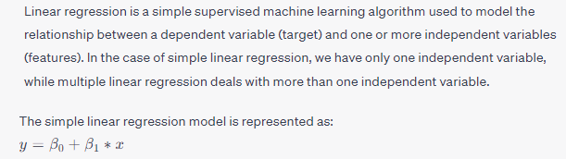
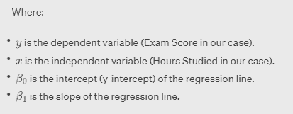


Linear Regression:

Slide 3
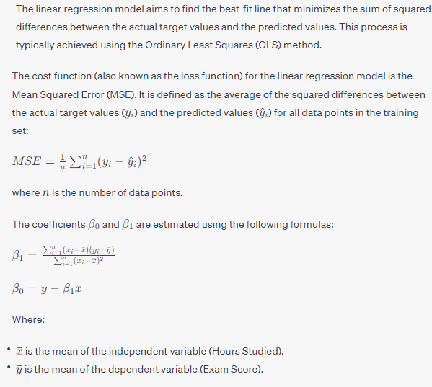
Mathematics behind the model :

Slide 4
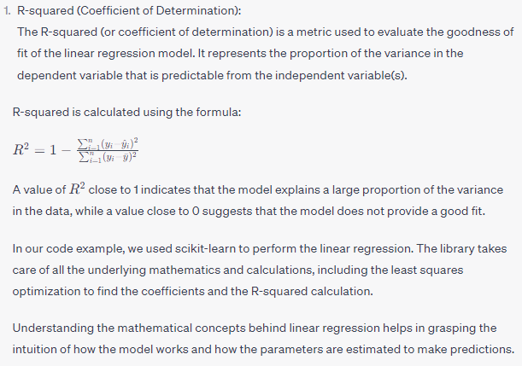
R - Squared:

Slide 5

Thank you
Follow me on LinkedIn & GitHub

